Slide 1

Advanced Stock Prediction Using Fin Bert & Semantic Search
GROUP-4
SAI HARSHA VARDHAN REDDY KOLAN
VEERA VENKATA SAI KALYAN KAPARAJU
KRISHNA PRIYA VALLURUPALLI
MOUNIKA DEVI NALLAPARAJU
HARSHINI JAMPANA

Slide 2

MOTIVATION
Navigating Market Volatility
Markets are inherently unpredictable due to numerous influencing factors.
Uncertainty is driven by both internal market dynamics and external events, making risk management crucial.
RISK REDUCTION, PROFIT MAXIMIZATION
UTILIZING ADVANCED MODELS CAN HELP MITIGATE RISKS AND IDENTIFY PROFITABLE OPPORTUNITIES.
MACHINE LEARNING MODELS OFFER SUPERIOR DECISION-MAKING THROUGH DATA-DRIVEN INSIGHTS.
Limitations of Traditional Models (Holt-Winters & ARIMA)
Conventional models, like Holt-Winters and ARIMA, struggle to capture non-linear relationships and external shocks, as they rely heavily on historical data and trends. This makes them less adaptable to real-time market shifts driven by external factors like sentiment and geopolitical events.
While effective for trends and seasonality, these models lack the flexibility needed to respond quickly to short-term volatility, limiting their ability to navigate complex, rapidly changing market conditions.

Slide 3

RESEARCH QUESTIONS
HOW CAN NEWS DATA BE INCORPORATED INTO PREDICTIVE MODELS FOR ACCURATE FORECASTING?
WHAT DEEP LEARNING METHODS CAN BE APPLIED TO TEXT DATA FOR PREDICTING STOCK MOVEMENTS AND WHAT ARE ITS LIMITATIONS?
How does the rise of transformer models address the limitations of traditional deep learning approaches?
How can transformer models suitable for text generation be adopted for numerical stock forecast?
Are there methods available to effectively filter relevant financial news pertaining to stocks from the extensive volume of market-related information?

Slide 4





DATA SOURCE
6000+ companies stocks news sourced from Kaggle from year 2009 -2021
Data pre-processing
Final Data
Ready for modeling
6000+ company’s Stock prices fetched using polygon API.

Slide 5
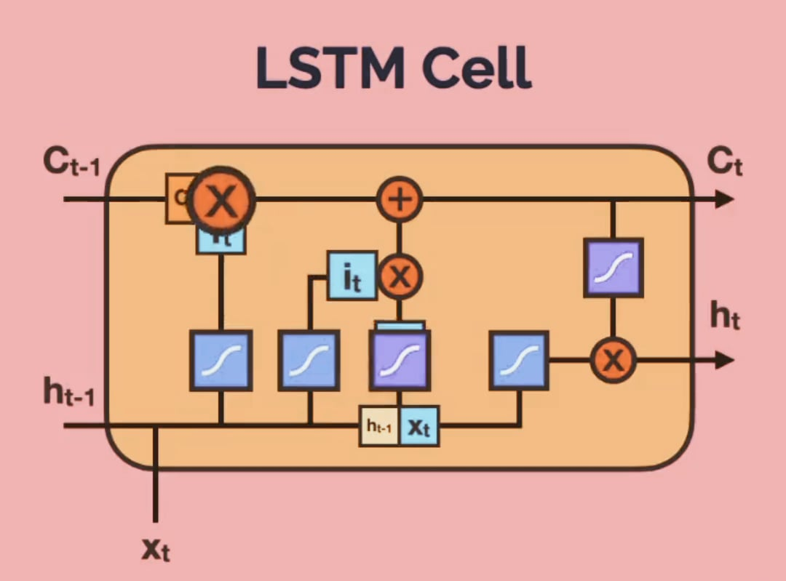
METHODOLOGY USING LSTM
Training Data
GloVe Embeddings
Loss function
Prediction
Actual
Linear Layer
Prediction

Slide 6
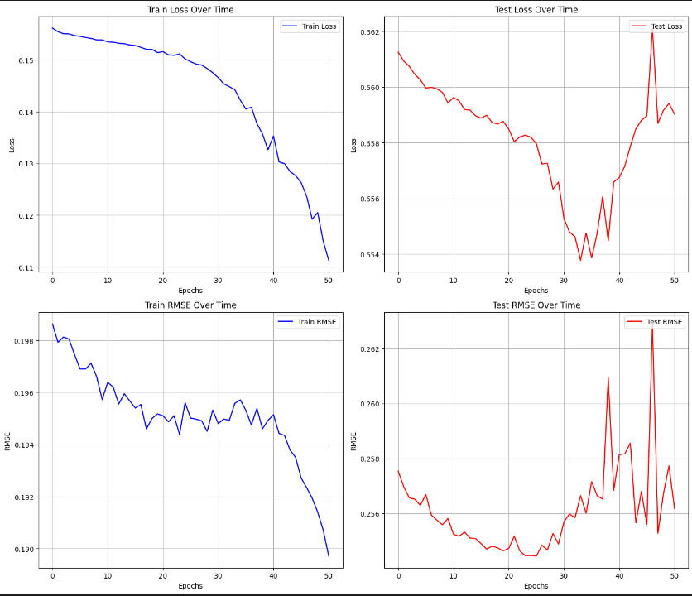
LSTM Performance Evaluation
LOSS: MSE (Mean Squared Error)
NUMBER OF EPOCHS: 50
EVALUATION METRIC: RMSE (Root Mean Squared Error)
HIDDEN STATES: 128
DROUPOUT: 0.3
BEST EPOCH: 34
MINIMUM TEST LOSS (MSE): 0.55377
MINIMUM TEST RMSE : 0.25444

Slide 7
Methodology USING FINBERT
STOCK-NEWS HEADLINES
TF- IDF VECTORIZER
FAISS
QUERY-VECTOR EMBEDDING
VECTOR EMBEDDINGS
LINEAR LAYER
ATTENTION-ENHANCED EMBEDDINGS
TOP 5 STOCK HEADLINES EMBEDDINGS
FINBERT
PREDICTION
LOSS FUNCTION
ACTUAL

Slide 8
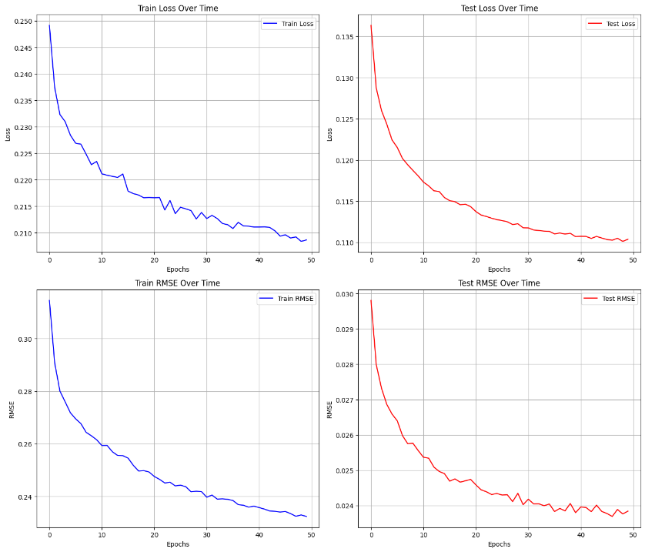
FinBert Performance Evaluation
LOSS: MSE (Mean Squared Error)
NUMBER OF EPOCHS: 50
EVALUATION METRIC: RMSE (Root Mean Squared Error)
HIDDEN STATES: 768
MAXIMUM TOKEN LENGTH: 64
BEST EPOCH: 49
MINIMUM TEST LOSS (MSE): 0.11011
MINIMUM TEST RMSE : 0.02369

Slide 9

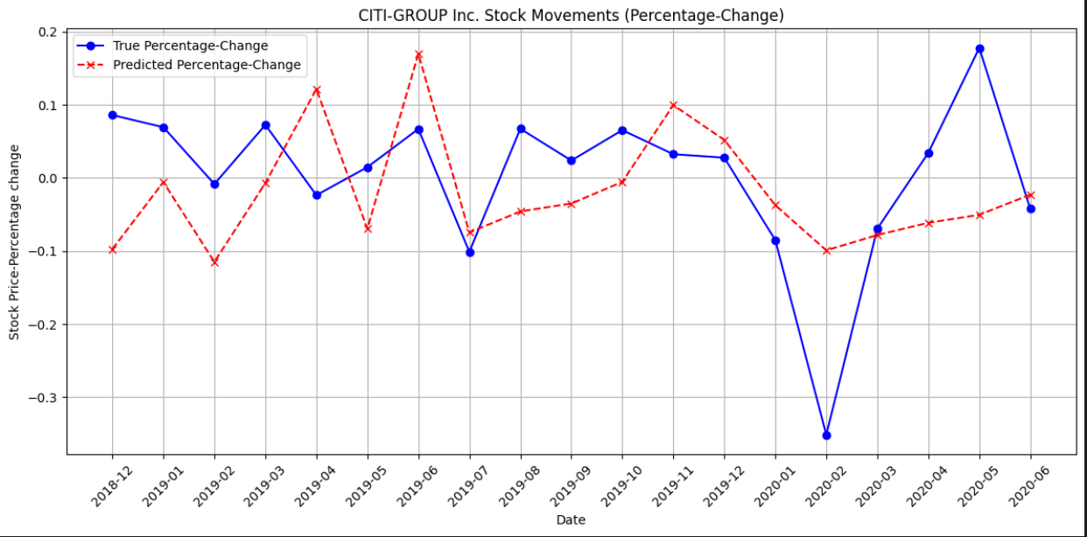
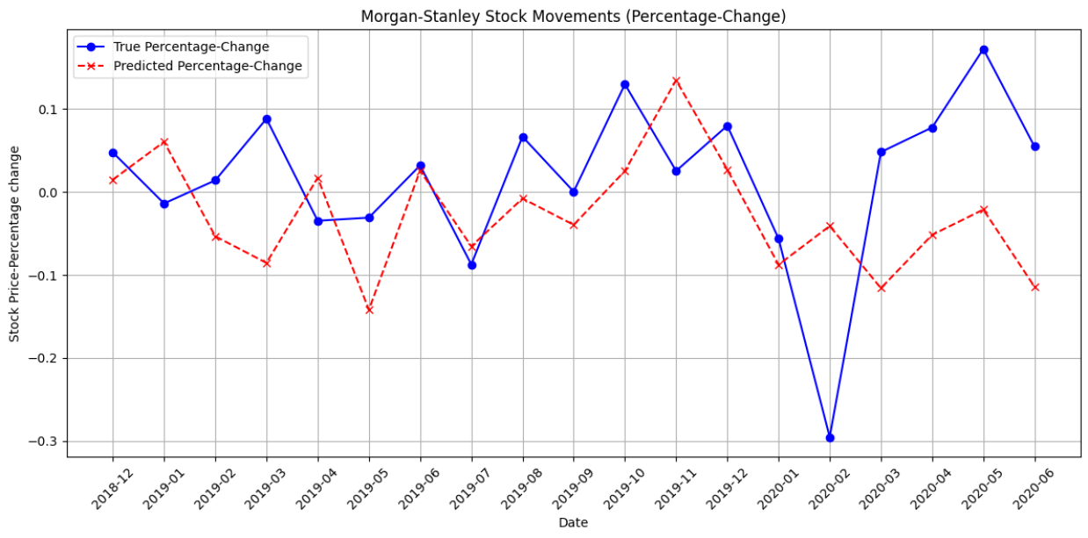
FinBert Performance On Some Major Stocks

Slide 10
Conclusion & Future Work
Performance Improvement From LSTM To Fin-Bert
Loss (MSE) Improvement: 0.44366
RMSE Improvement: 0.23075
Future Improvements
Integrate APIs like Polygon API for live stock prices and Bing Search News or Yahoo Finance API for up-to-date financial news.
Build robust data pipelines to automate the ingestion and preprocessing of real-time data for seamless model updates.
Incorporate Retrieval-Augmented Generation (RAG) systems to enhance insights by combining live data retrieval with the model's responses.
Design and develop a user-friendly web application to serve as the interface, enabling users to interact with the model and access real-time insights.
When working with similarity search we can use IVF (Inverted File Index) or HNSW (Hierarchical Navigable Small World) algorithms to improve speed for large datasets.

Slide 11

Thank you
- GROUP 4

